Slide 1
MIMIC CXR Abnormalities Detection

Slide 2
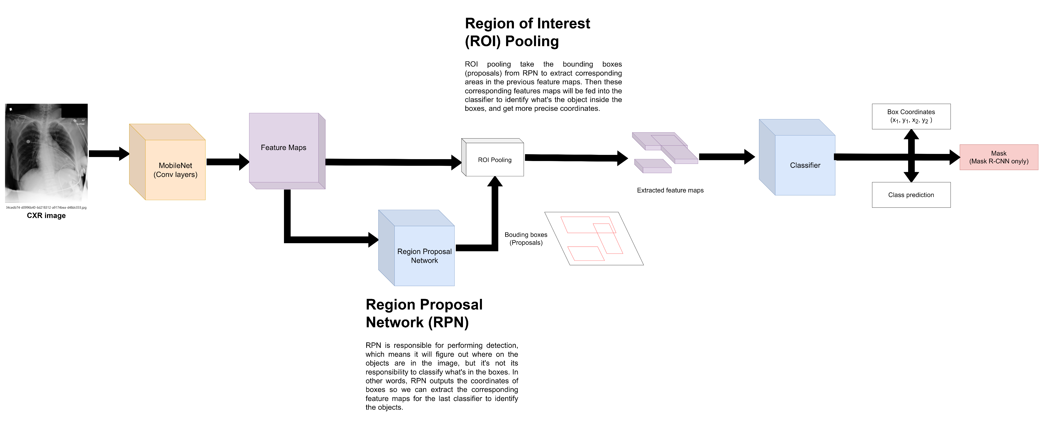
Original Faster R-CNN/Mask Detection

Slide 3
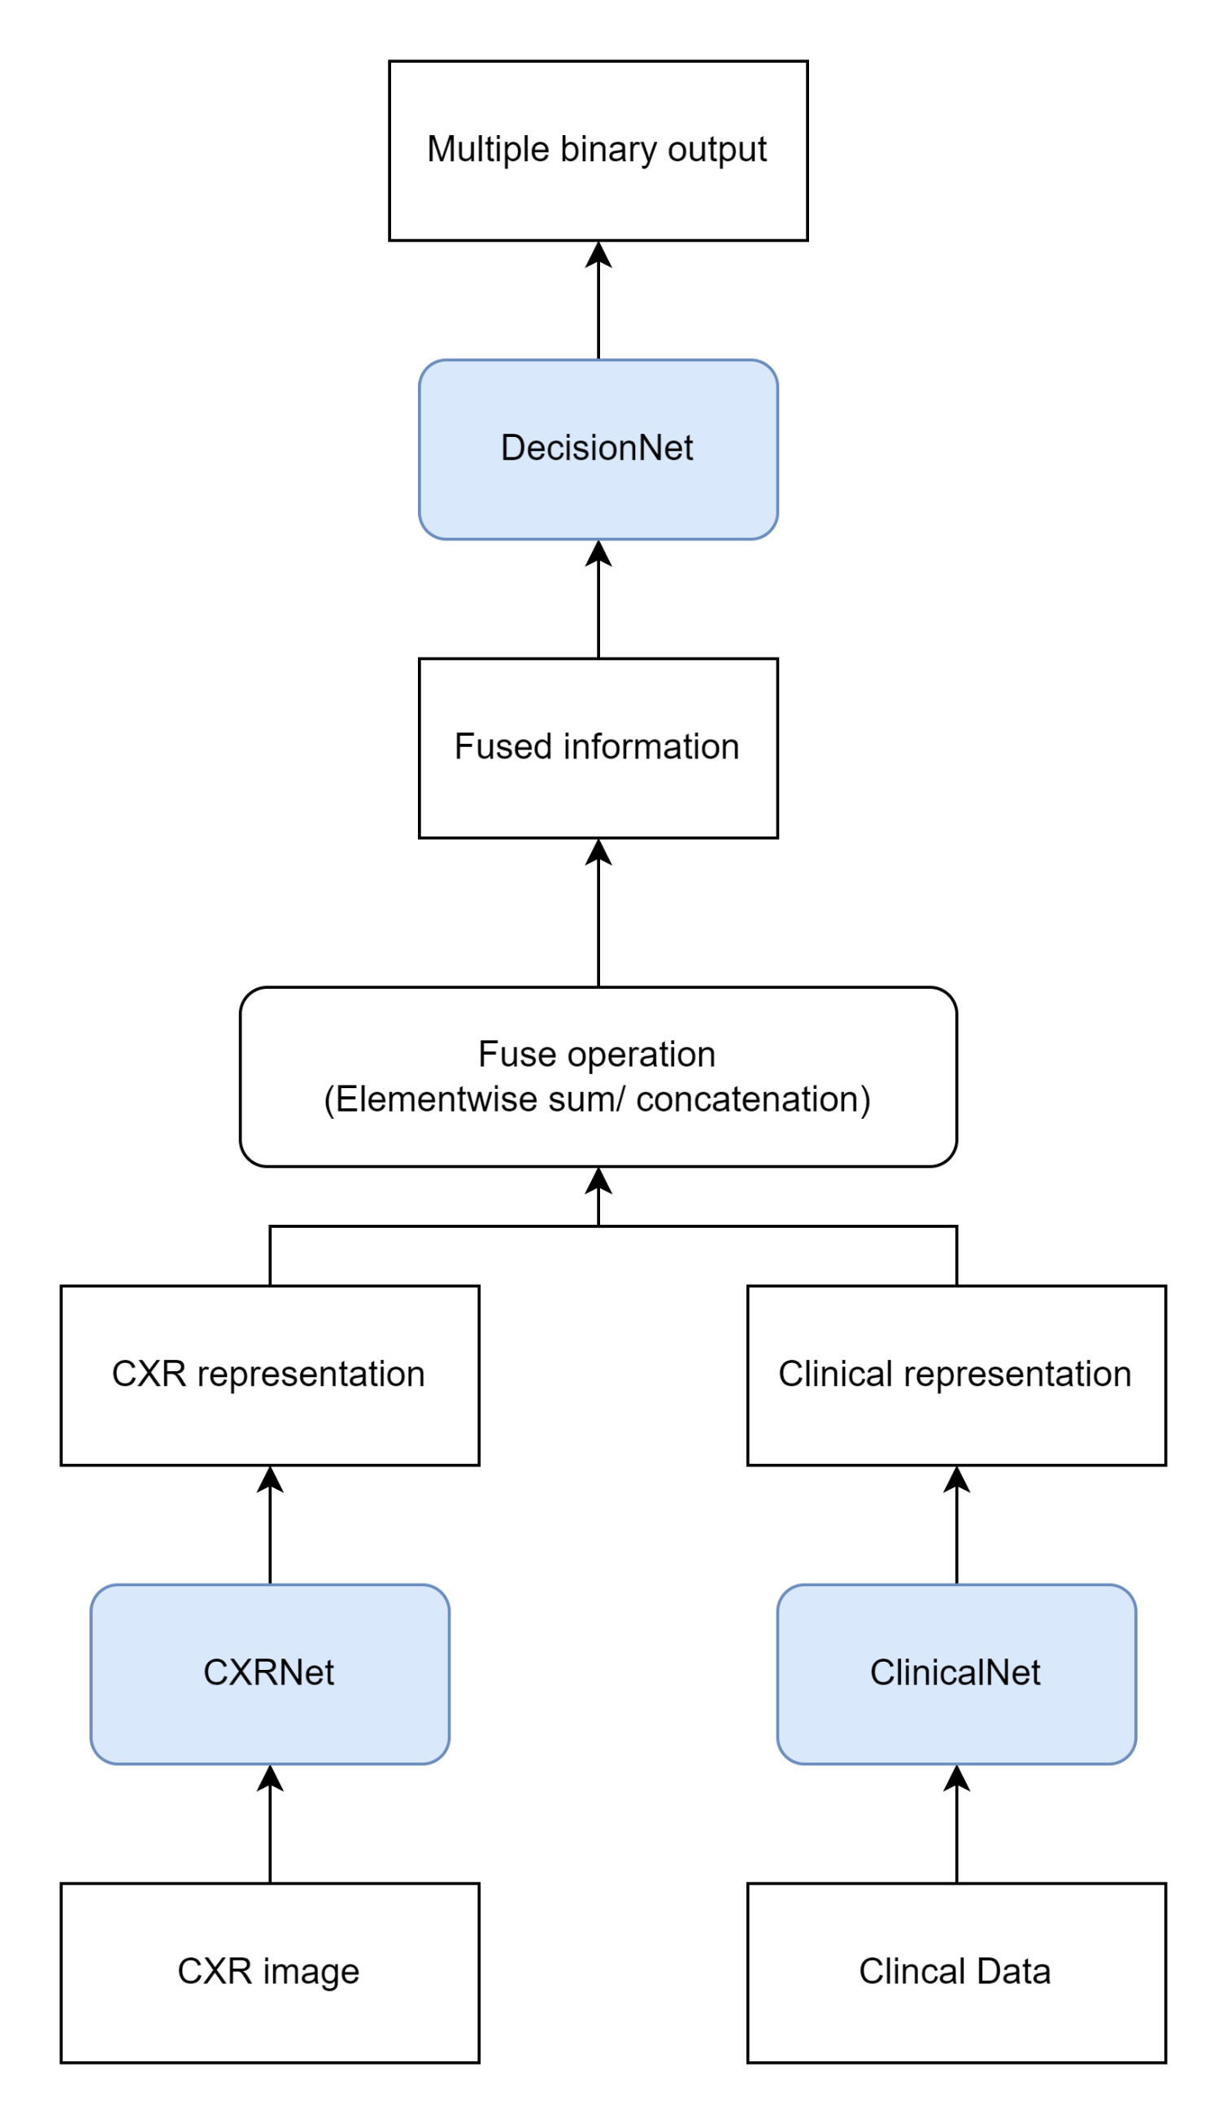
Previous Multimodal Architecture

Slide 4
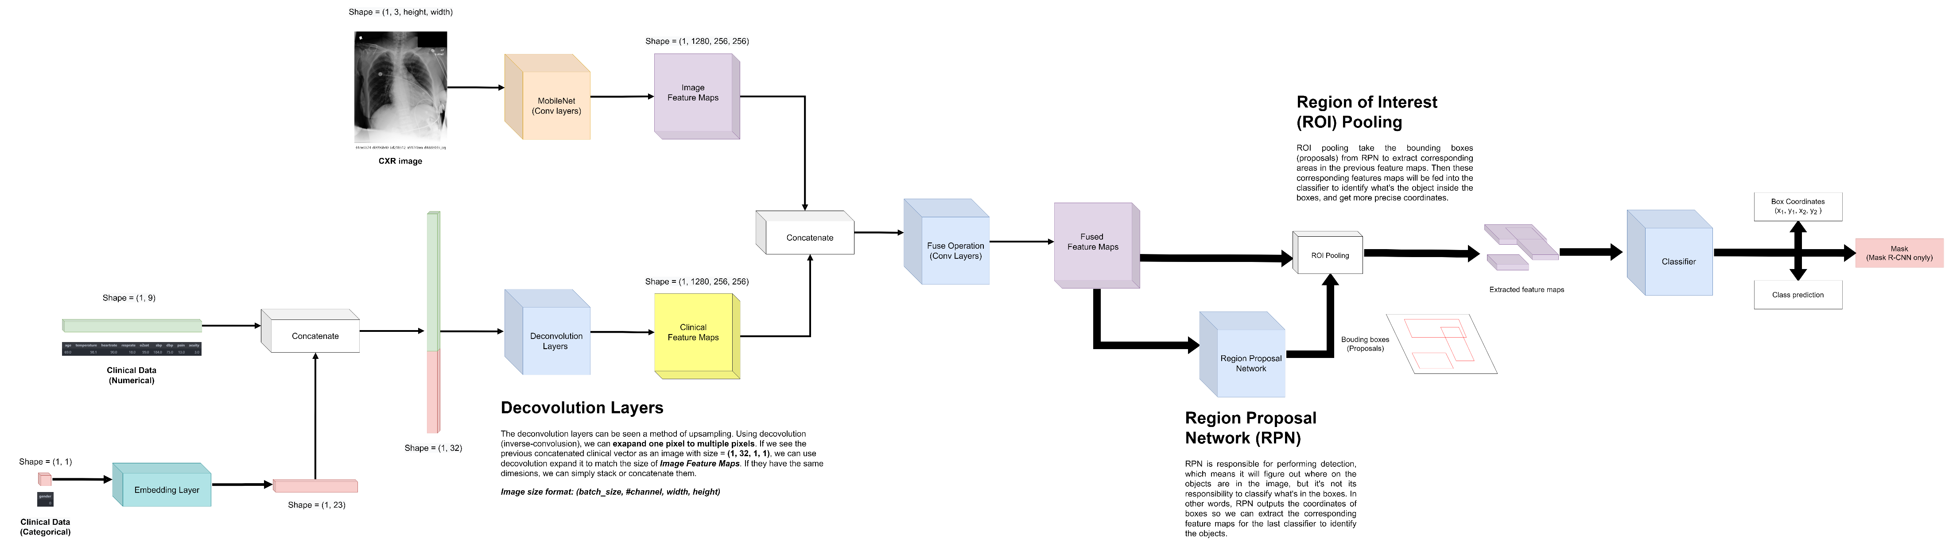
Proposed Multimodal Faster/Mask R-CNN

Slide 5
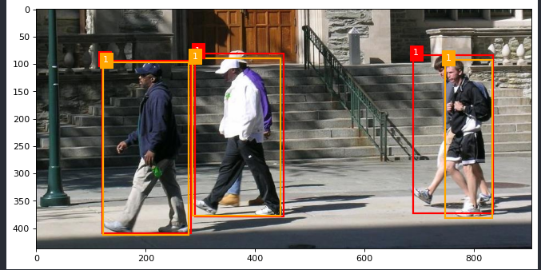
Experiment 1:
Model: Original Faster R-CNN
Dataset: Pedestrian Dataset
Epoch: 10
Ground Truth
Prediction

Slide 6
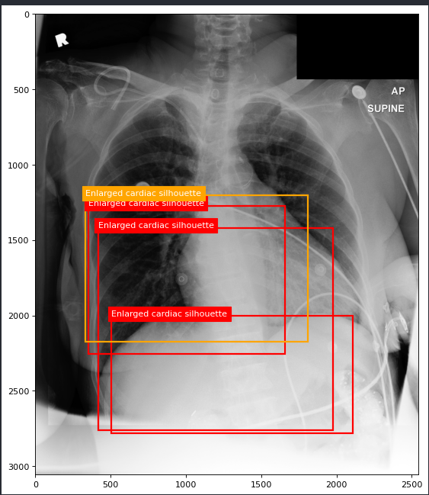
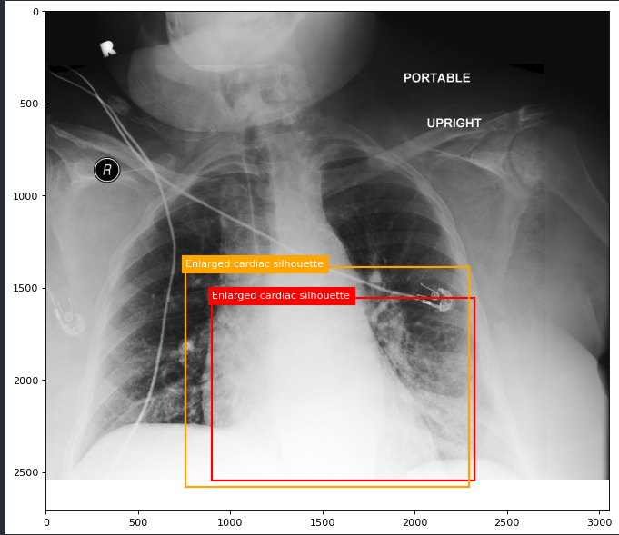
Experiment 2:
Model: Original Faster R-CNN
Dataset:
- REFLACX Dataset without clinical (Enlarged cardiac silhouette only)
- 674 cases
Epoch: 10
It perform OKAY.

Slide 7
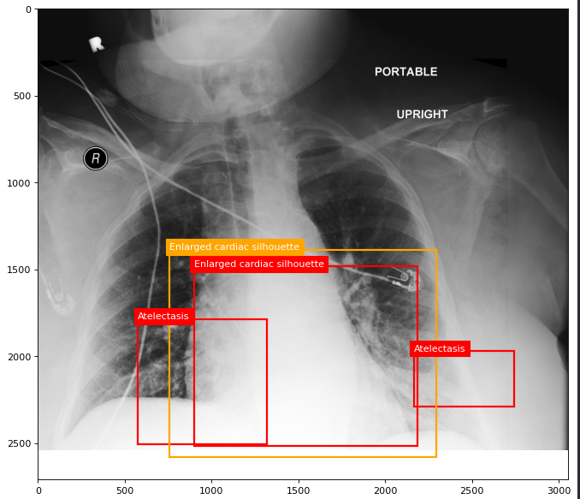
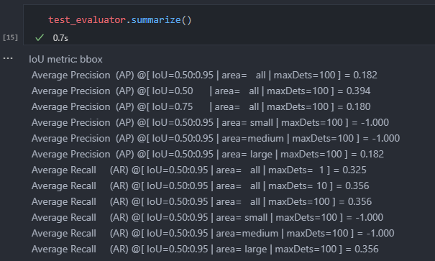
Experiment 3:
Model: Original Faster R-CNN
Dataset:
- REFLACX Dataset without clinical (Enlarged cardiac silhouette& Atelectasis)
- 674 cases
Epoch: 10

Slide 8
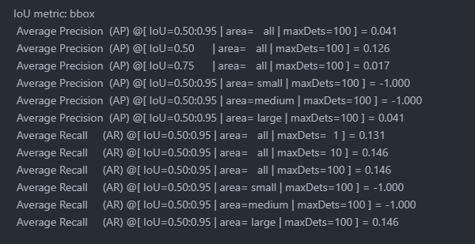
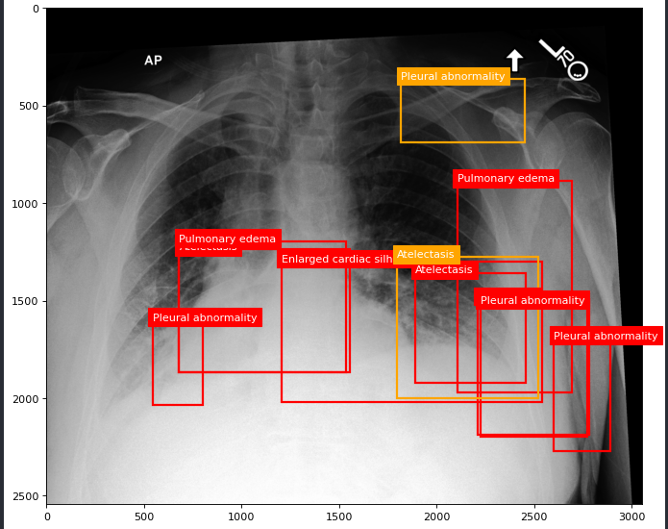
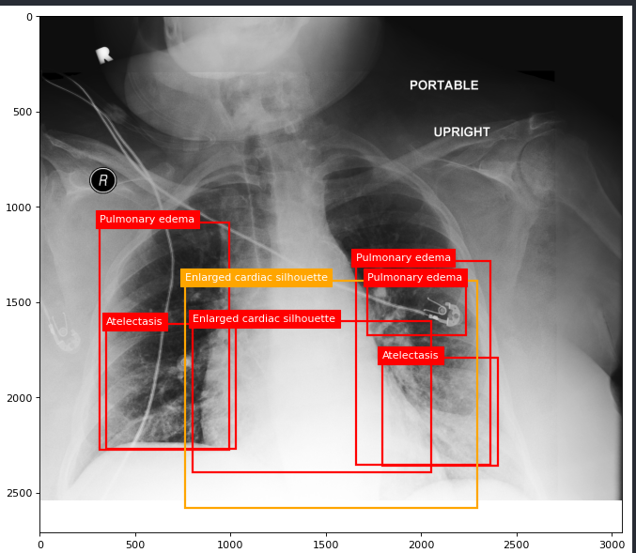
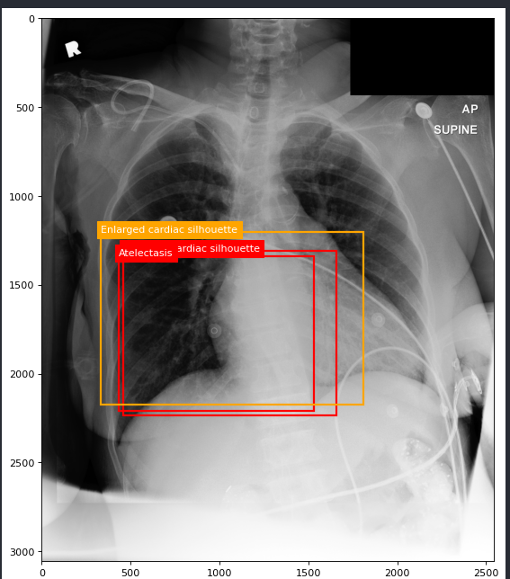
Experiment 4:
Model: Original Faster R-CNN
Dataset:
- REFLACX Dataset without clinical (top5 diseases)
- 674 cases
Epoch: 10

Slide 9
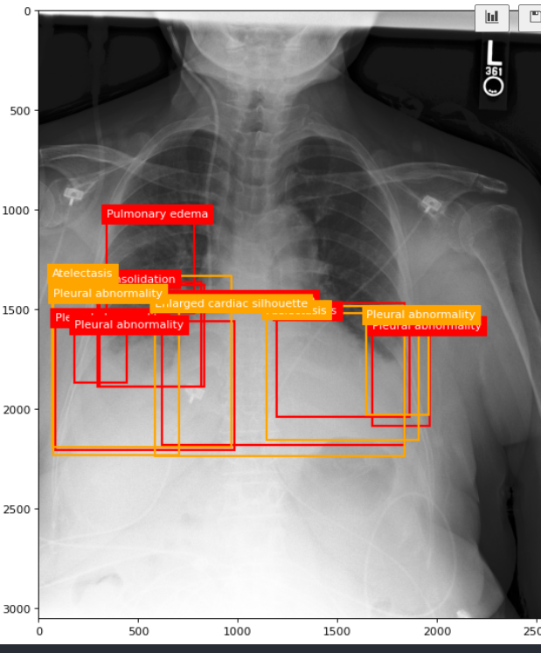
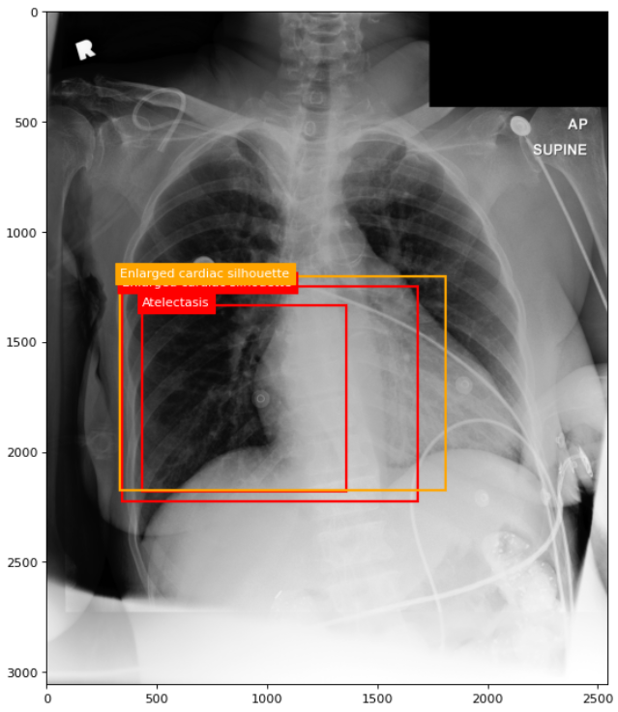
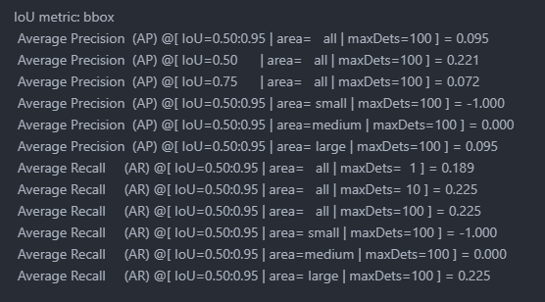
Experiment 5:
Model: Original Faster R-CNN
Dataset:
- REFLACX Dataset without clinical (top5 diseases)
- 3207 cases
Epoch: 10

Slide 10
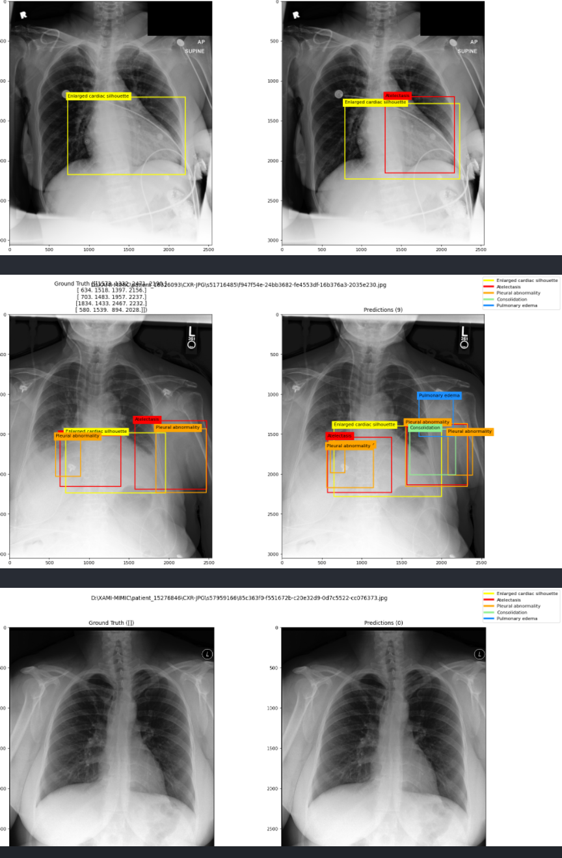
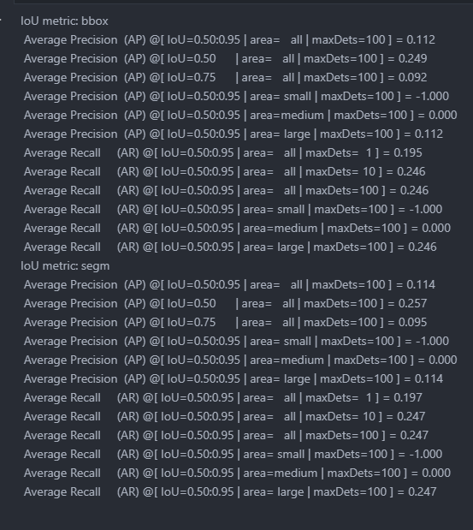
Experiment 6:
Model: Original Mask R-CNN
Dataset:
- REFLACX Dataset without clinical (top5 diseases)
- 3207 cases
Epoch: 10

Slide 11
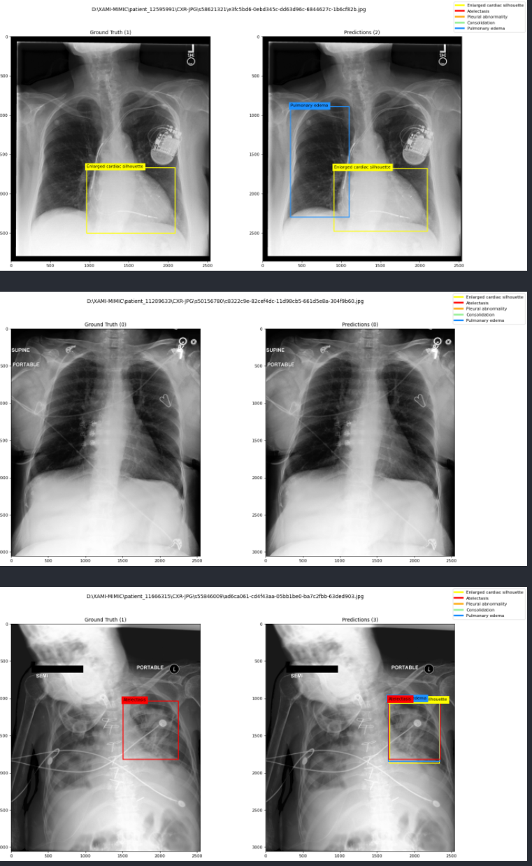
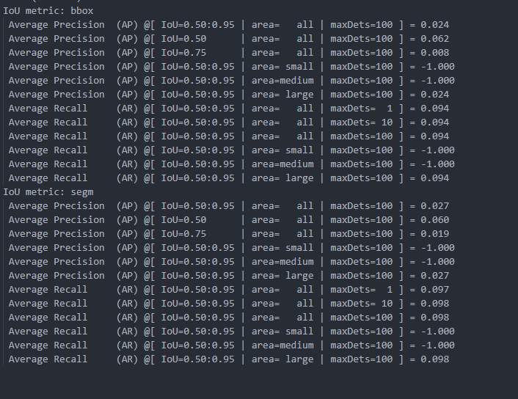
Experiment 7:
Model: Original Mask R-CNN
Dataset:
- REFLACX Dataset without clinical (top5 diseases)
- 674 cases
Epoch: 10

Slide 12
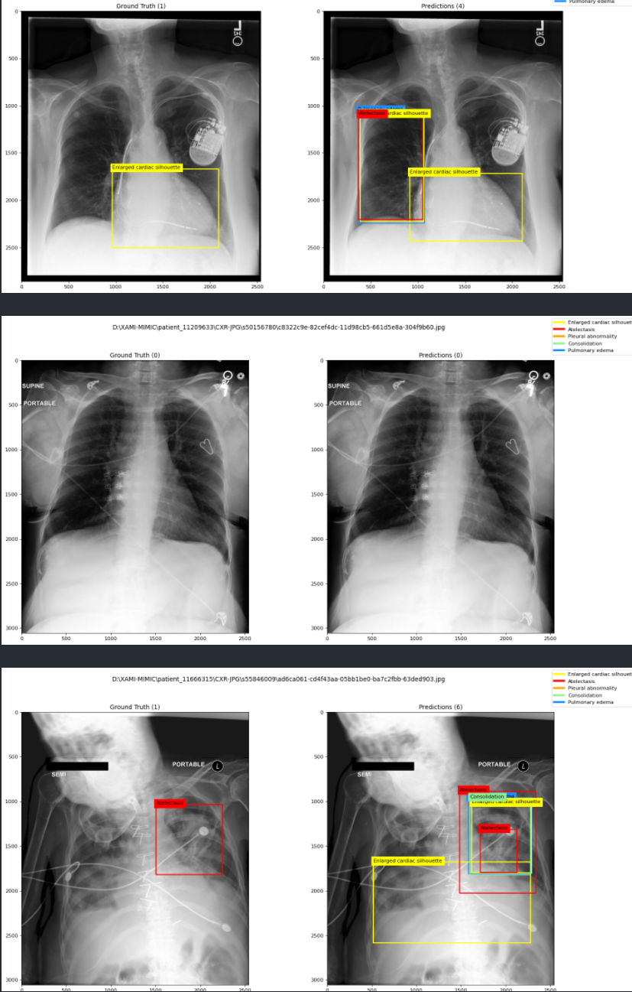
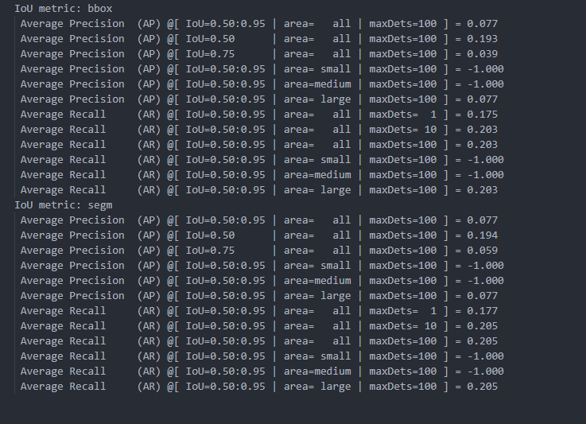
Experiment 8:
Model: Our custom modal.
Dataset:
- REFLACX Dataset without clinical (top5 diseases)
- 674 cases
Epoch: 10

Slide 13
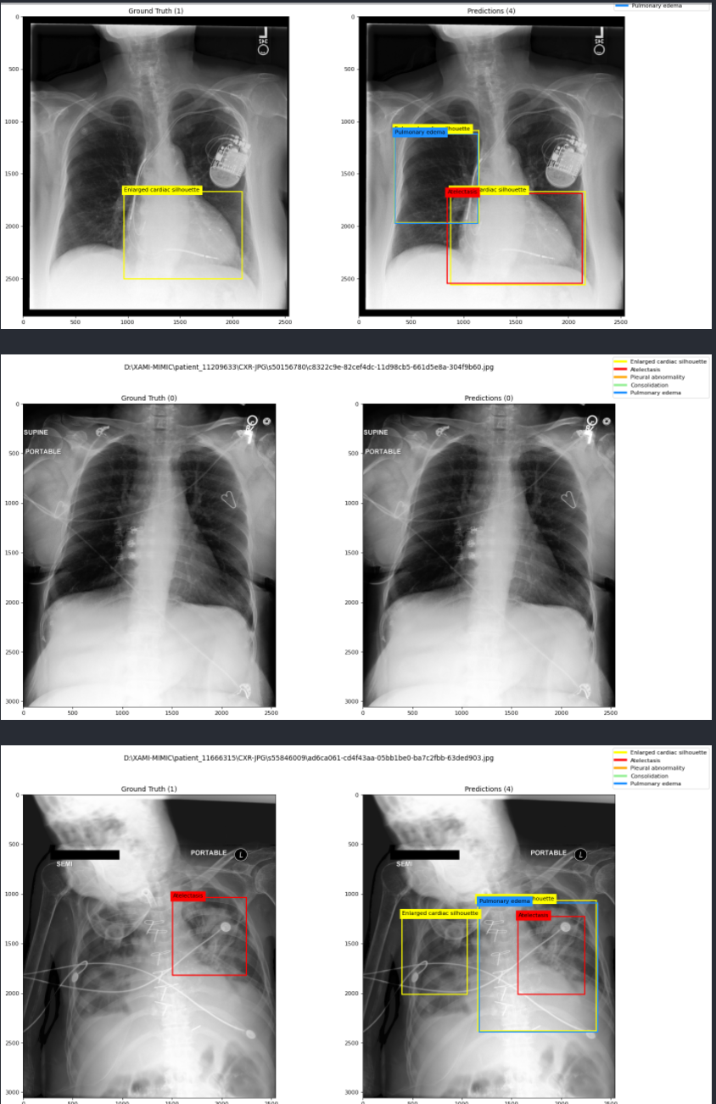
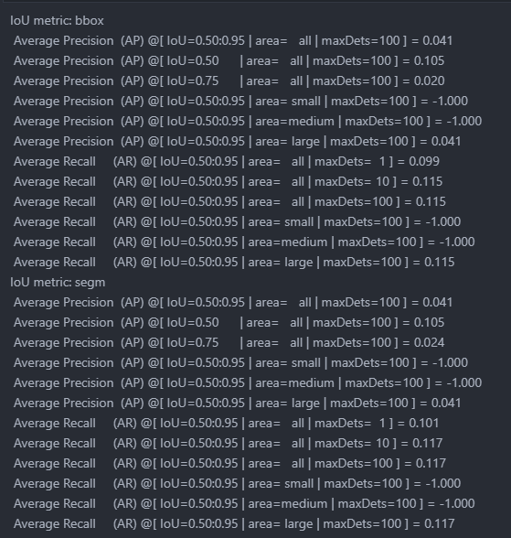
Experiment 9:
Model: Our custom modal.
Dataset:
- REFLACX Dataset with clinical (top5 diseases)
- 674 cases
Epoch: 10

Slide 14
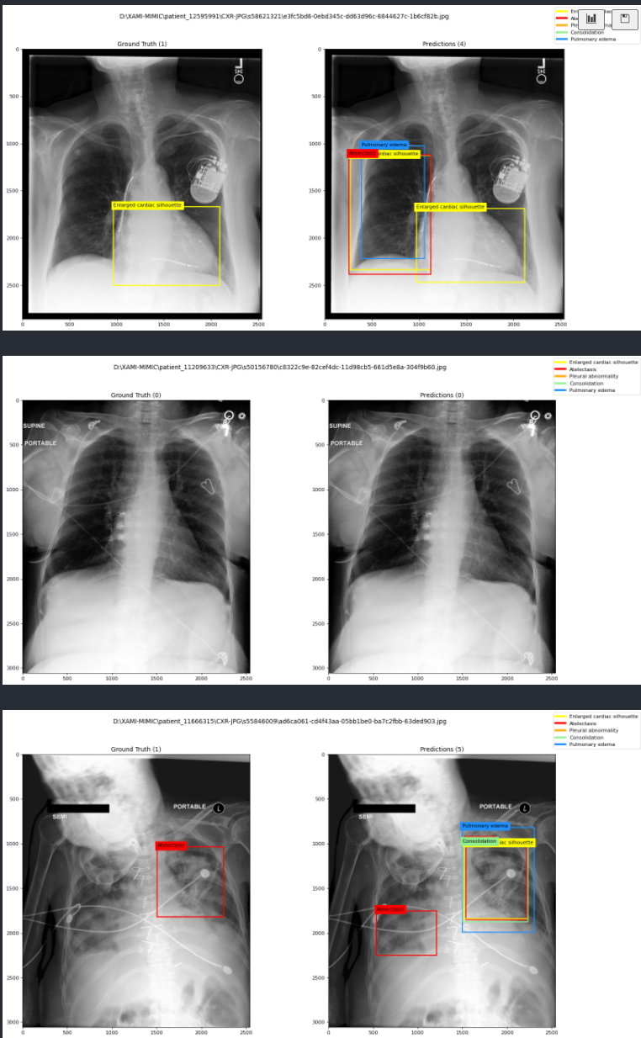
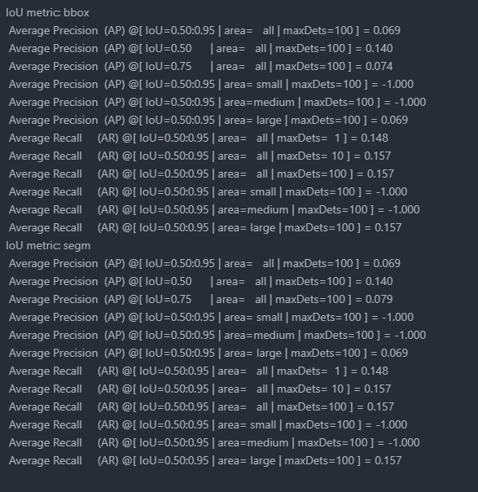
Experiment 10:
Model: Our custom modal.
Dataset:
- REFLACX Dataset without clinical (top5 diseases)
- 674 cases
Epoch: 100

